Slide 1
Electric Vehicle Population Data Analytics
An Analysis of EV Trends in Washington State
SAKINAM AKSHAY KUMAR
sakinamakshay@gmail.com
https://www.linkedin.com/in/akshay-kumar-sakinam-516502255/

Slide 2
Dataset Overview
Source: https://catalog.data.gov/dataset/electric-vehicle-population-data (Electric_Vehicle_Population_Data.csv)
Records: 261,698
Columns: 17
Description: Dataset shows Battery Electric Vehicles (BEVs) and Plug-in Hybrid Electric Vehicles (PHEVs) registered through Washington State Department of Licensing (DOL).

Slide 3
Key Columns Analyzed
County — county where the vehicle is registered
Model Year — manufacturing year of the vehicle
Make — manufacturer (e.g., TESLA, FORD)
Electric Vehicle Type — BEV or PHEV
Electric Range — range in miles on a single charge
Base MSRP — Manufacturer's Suggested Retail Price

Slide 4
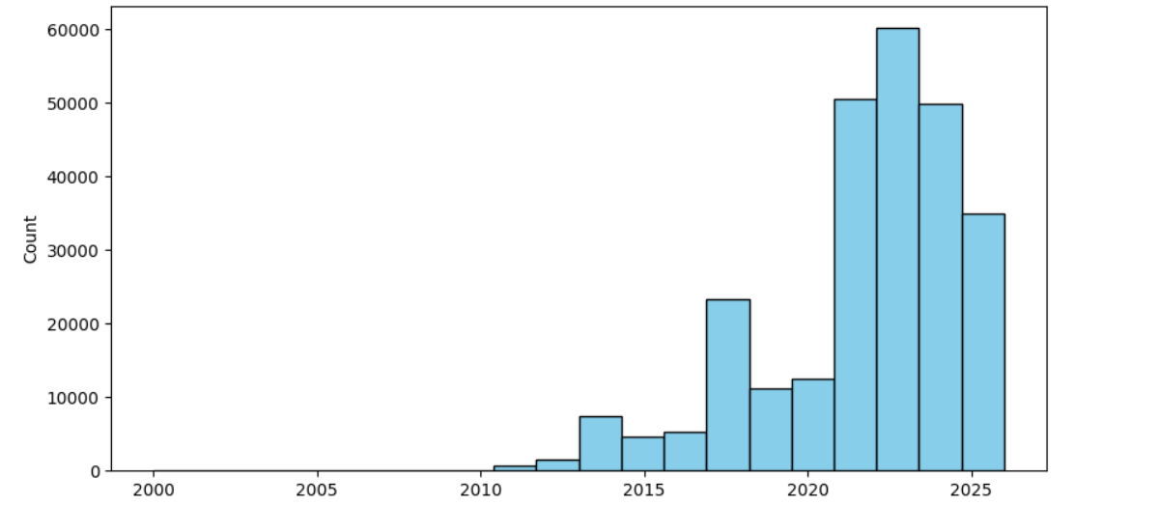
EV Population Trend by Model Year
Chart shows number of registered EVs by model year
Insight: Significant increase in EV registrations began around 2018
Rapid growth between 2020 and 2024 indicating accelerating market adoption

Slide 5
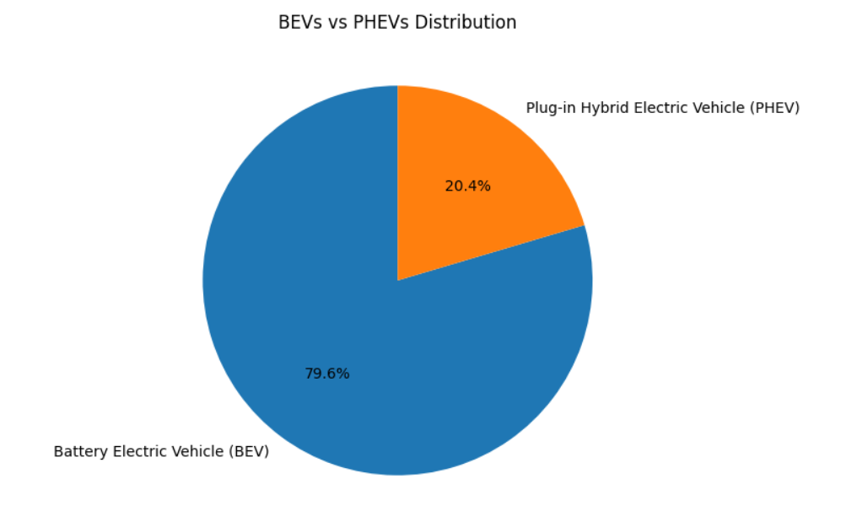
BEV vs. PHEV Distribution
Chart illustrates proportion of BEVs vs PHEVs
Insight: BEVs make up nearly 80% of the EV population in Washington State
PHEVs constitute a smaller but significant portion of the market

Slide 6
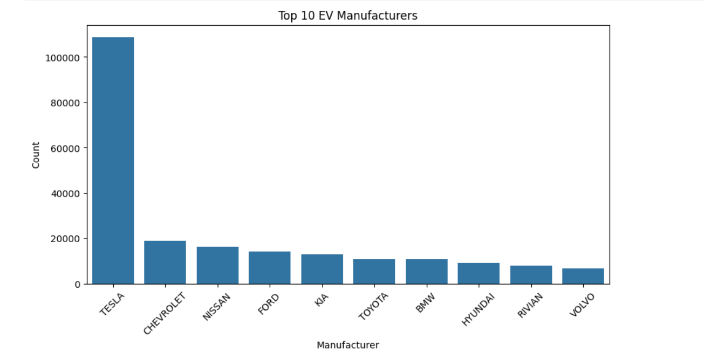
Top 10 EV Manufacturers
Plot ranks top 10 manufacturers by number of registered EVs
Insight: TESLA is the market leader by a large margin
Traditional automakers (NISSAN, CHEVROLET, FORD) also have strong presence; followed by KIA, BMW, etc.

Slide 7
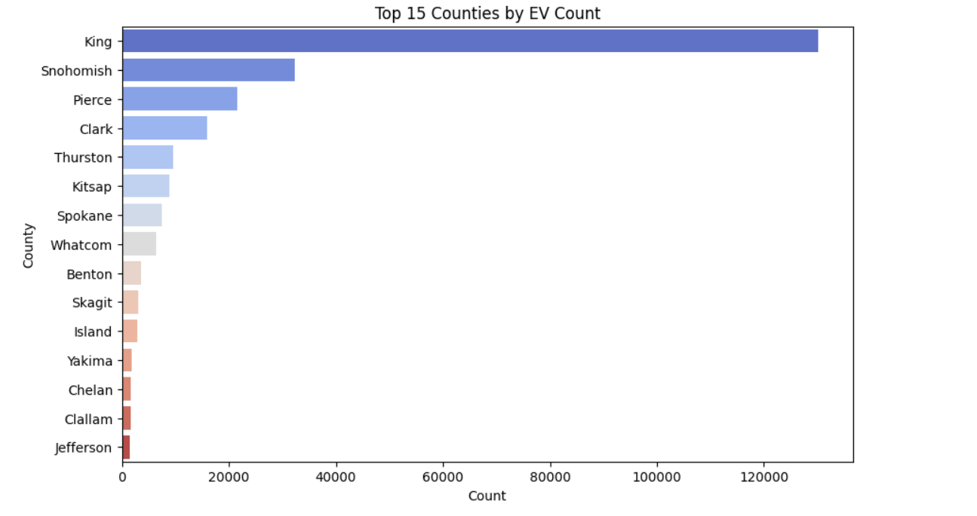
Top 15 Counties by EV Count
Chart shows number of registered EVs in top 15 counties
Insight: King County has highest concentration, followed by Snohomish and Pierce
Suggests higher adoption in/around metropolitan areas

Slide 8
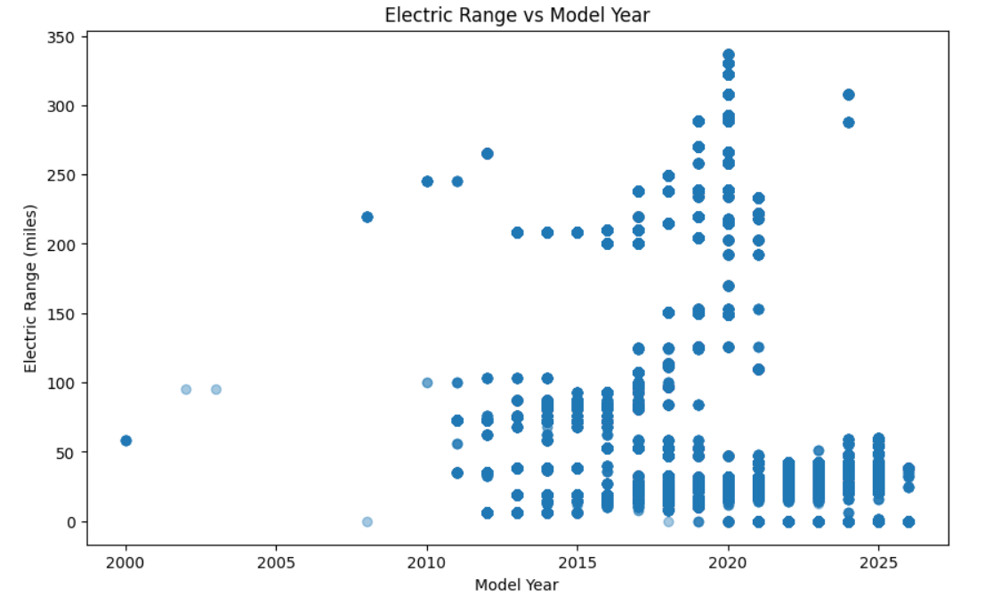
Electric Range by EV Type
Box plot compares distribution of electric range for BEVs vs PHEVs
Insight: BEVs have much higher median range than PHEVs
BEV ranges are widely distributed; PHEVs are more concentrated and lower as expected

Slide 9
Technologies Used for Analysis
Python — core language for analysis
Pandas — data manipulation & exploration
Matplotlib & Seaborn — visualizations
Apache Spark (PySpark) — large-scale processing and aggregation

Slide 10
Conclusion
Dataset contains over 260,000 registered EVs in Washington State — robust sample for analysis
BEVs dominate (~80%); Tesla is leading manufacturer
EV adoption increased significantly since 2018, accelerating 2020–2024
Electric range varies widely; BEVs offer substantially higher ranges than PHEVs
King & Snohomish counties have the highest EV concentrations — urban/suburban hotspots
Dataset useful for studying EV adoption trends, infrastructure planning, and clean energy initiatives

